Slide 1
Registry & Chrome Forensics

Slide 2



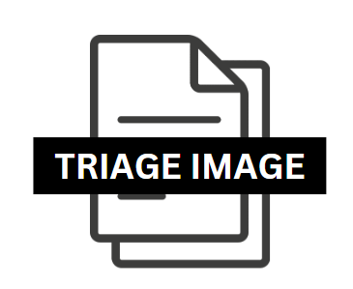


The Imaging Process for Triage

Slide 3
Windows Registry

Slide 4
Windows Registry
⬥A series of database files that record Windows’ configuration, settings and some user preferences
⬥System-wide registry files are located in the C:\Windows\System32 folder
⬥The five core registry “hives” are:
⬦SAM: reflects local user accounts and groups
⬦SYSTEM: overall system service and attached hardware data
⬦*SECURITY: security info like audit policies & security IDs
⬦SOFTWARE: config for installed applications, including the OS
⬦*DEFAULT: global environmental variables overwritten by user-level settings
⬥*not typically very useful

Slide 5
User-Level Hives
⬥NTUSER.dat: in post-WindowsXP systems, located in C:\Users\[username]\ntuser.dat (on XP systems, it was in the “Documents and Settings” folder)
⬥EXTREMELY useful registry hive containing most user-level settings and some user activity, like browsing info
⬥ USRCLASS.dat: introduced in Windows Vista, located in C:\Users\[username]\AppData\Local\Microsoft\Windows\usrclass.dat.
⬥This hive stores settings related to Windows’ User Account Control (serves as a security buffer between applications and the registry, to avoid giving applications blanked system-level privileges) and its relation to files and folders. So, some valuable data here relating to shellbags (we’ll cover those later) and a few other artifacts

Slide 6
SAM Hive
⬥Remember, the SAM hive holds account and user information (at the system level).
⬥With the SAM hive loaded, go to the ROOT\SAM\Domains\Account\Users folder. Click the “User Acounts” tab in the data pane to see user accounts. Scroll down to the bottom to see user-level (not system or service-level) accounts.

Slide 7
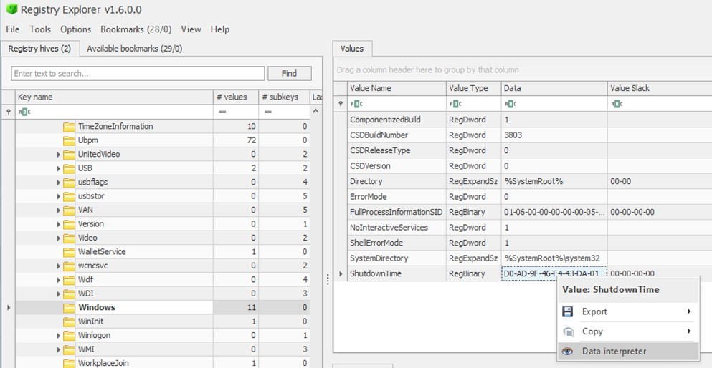
System Hive
⬥In the SYSTEM hive, document the following values of interest:
⬦SYSTEM\[CurrentControlSetFolder]\Control\ComputerName\ComputerName\Data
⬦SYSTEM\[CurrentControlSetFolder]\Control\TimeZoneInformation\TimeZoneKeyName
⬦SYSTEM\[CurrentControlSetFolder]\Control\Windows\ShutdownTime
⬦SYSTEM\[CurrentControlSetFolder]\Services\Tcpip\Parameters\InTerfaces\DHCPDomain
⬦ SYSTEM\CurrentControlSet\Services\Tcpip\Parameters\Interfaces

Slide 8
Software Hive
⬥Document the following SOFTWARE hive values:
⬦SOFTWARE\Microsoft\Windows NT\Current Version\ProductName
⬦SOFTWARE\Microsoft\Windows NT\Current Version\ReleaseID
⬦SOFTWARE\Microsoft\Windows NT\Current Version\CurrentBuild
⬦SOFTWARE\Microsoft\Windows NT\Current Version\InstallDate (interpret it)
⬦SOFTWARE\Microsoft\Windows NT\Current Version\RegisteredOwner
⬦SOFTWARE\Microsoft\Windows NT\Current Version\NetworkList (make sure you’re looking at the “Known networks” tab)…document the Network Name, Name Type, First Connect LOCAL and Last Connected LOCAL times

Slide 9
NTUSER.DAT
⬥Document the following NTUSER.DAT hive values:
NTUSER.DAT\Software\Microsoft\Windows\Currentversion\Explorer\UserAssist\
Shows recently launched applications
⬦NTUSER.DAT\Software\Microsoft\Windows\CurrentVersion\Explorer\WordWheelQuery
⬩This is a record of any search terms that have been typed in the desktop “Search” field. If there is not a folder, it is likely the desktop Search hasn’t been used.
⬦NTUSER.DAT\Software\Microsoft\Windows\CurrentVersion\Explorer\TypedPaths
⬦This shows any queries typed into Windows Explorer’s built-in “Search” field
⬦NTUSER.DAT\Software\Microsoft\Windows\CurrentVersion\Explorer\RecentDocs
⬩This shows all the recent documents, and the order in which they were opened (via the MRU key). Which document was most recently opened?
⬦Validate the info above by looking at the
NTUSER.DAT\Software\Microsoft\Windows\CurrentVersion\Explorer\ComDlg32\OpenSavePidlMRU values. What information is available here that wasn’t available in the RecentDocs values?

Slide 10
Chrome & Edge Forensics

Slide 11
Chrome Forensics
⬥Chrome has multiple databases of different types (SQLite, JSON, SNSS) to track history artifacts
⬥The majority are SQLite databases stored in the \%UserProfile%\Appdata\Local\Google\Chrome\<Profile> folder
⬥The SQLite databases do not have file extensions
⬥The “History” database, in particular, is full of potentially useful artifacts

Slide 12
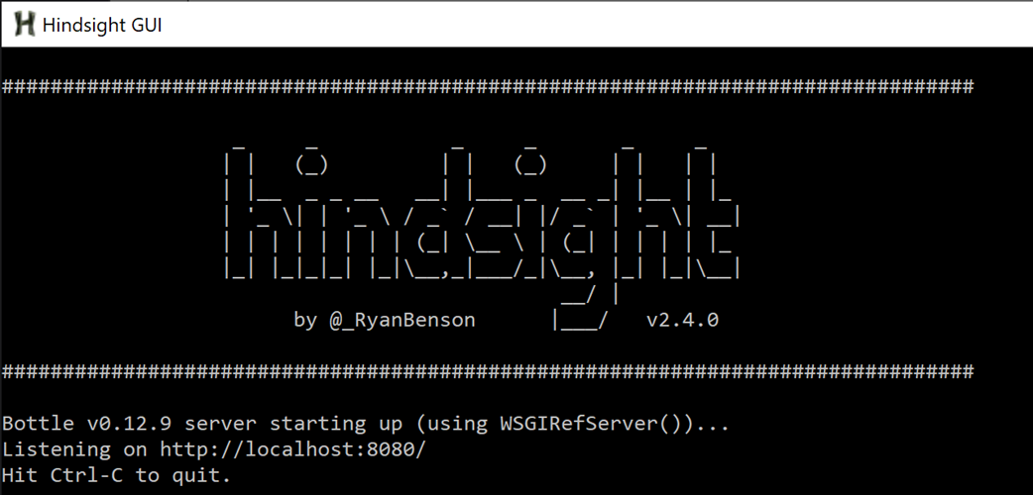
Tooling: Hindsight
⬥ Hindsight is a great Chrome forensic tool written by Ryan Benson
⬥Launch Hindsight from the desktop’s “DFIR Tools\Browser Tools” folder. Do this by double-clicking the “Hindsight GUI” executable
⬥Hindsight runs as a web service, so we now need to launch a browser window and go to “localhost:8080” to see Hindsight’s webpage

Slide 13
Tools Used to Do all This
Arsenal Image Mounter: Mounts images and makes them available for use for GKAPE and Hindsight
GKAPE: Takes mounted image and grabs multiple key artifacts to create a triage image
Hindsight: Takes chrome artifacts and compiles them into a xlsx sheet for easier viewing
Registry Explorer: Takes registry hives and makes them easier to view and decipher

